Slide 1
Tracking ecosystem in desktop vs. mobile platforms
Team- Vaishnavi, Abhilasha, Niharika

Slide 2
Motivation for the project
Are the websites and apps really “free”?
Leak of sensitive data in exchange of “free” apps
Apps collect privacy-sensitive information and share it with third parties such as ad networks and analytics services without consent.
Identifying information leaked through mobile and desktop
Device name, type, carrier network, browser, location
User agent string of mobile contains device model number
Desktop users can be tracked through their network IP address

Slide 3
Related Work
1) Tracking the Trackers: Towards Understanding the Mobile Advertising and Tracking Ecosystem
Conducts study with ICSI Haystack Lumen App and gives insights of different trackers across the android app.
The Web’s Sixth Sense: A Study of Scripts Accessing Smartphone Sensors
Studies smartphone sensor by extending OpenWPM tool to mobile, also detects fingerprinting on mobile platform
Online Tracking: A 1-million-site Measurement and Analysis
Focuses on analysing 15 metrics including stateless and stateful tracking for 1 million sites using OpenWPM

Slide 4
Problem Statement
This project aims to analyse the third party requests and tracking data in app, mobile and desktop browser to answer the following questions:
Do mobile contains more trackers than desktop?
Are there any trends in tracking behaviour across both the platforms?
Can we draw conclusions on tracking behaviour based on the type of domain of website?

Slide 5
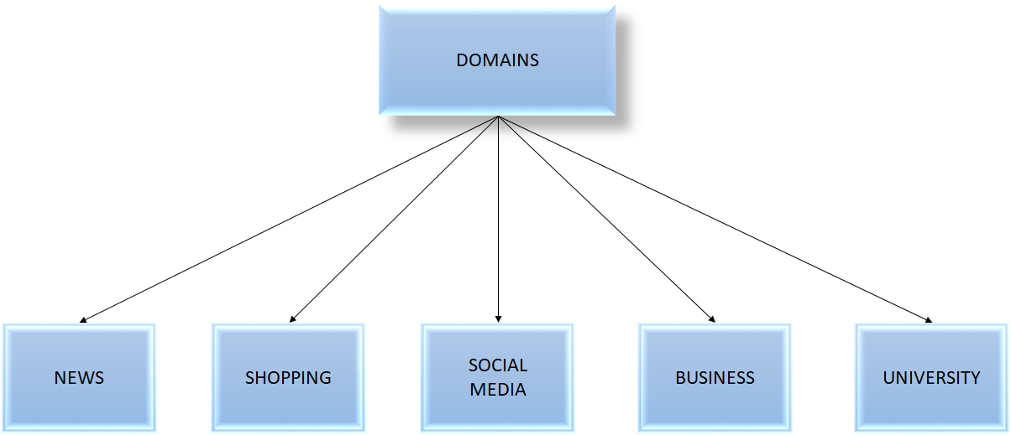
Proposed Approach

Slide 6
Data Collection Methodology
WHERE
Mobile(Browser) & Desktop (Browser) - Ghostery Platform
Mobile (Applications) - Lumen Platform
Desktop(Browser) - OpenWPM
HOW
Download the ghostery extension on mobile and desktop
Download the Lumen app and browse the app to see the trackers
OpenWPM crawl script
WHAT
Find the blacklisted website count on Mobile vs Desktop
Find the blacklisted website unique to Mobile and Desktop
Find trackers in Android apps of websites
Extract third party requests and http response data

Slide 7
Study / Experiment design

Slide 8
Lumen Privacy Monitor:
Monitors the behaviour of the app over the network by analyzing the traffic to display follow information:
No. of trackers blocked while visiting the app
No. of third party requests
The data that is shared with third parties
Dangerous data leaks
Detailed traffic analysis reports that display the common trackers, amount of traffic wasted on advertising

Slide 9
Ghostery: Browser(Mobile Web) and Extension(Desktop)
It helps us analyse the following while browsing the websites on Mobile vs Desktop
No. of trackers trying to track while visiting the website
No. of trackers that were being blocked
Categorise the trackers into the following domains :
a) Advertising
b) Site Analytics
c) Social Media
d) Essential Trackers
e) Customer interactions
Identify the trackers blacklist unique to Mobile and Desktop

Slide 10
Open WPM Framework:
Open WPM is an automated Web Privacy Measurement Framework designed to crawl large number of websites. It is built on top of Firefox and automated using Selenium. It provides the following:
Can crawl large number of websites in an automated manner
Collects http requests, http response metadata
Collects javascript cookies and flash cookies
Collects navigations and redirects during each crawl

Slide 11
Evaluations

Slide 12
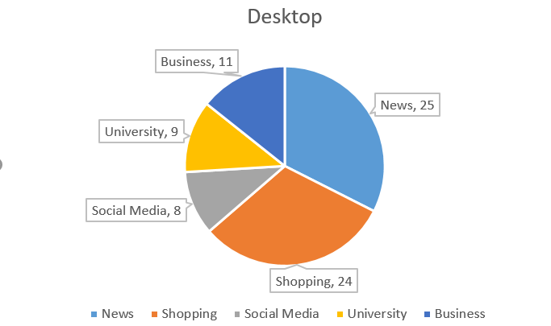
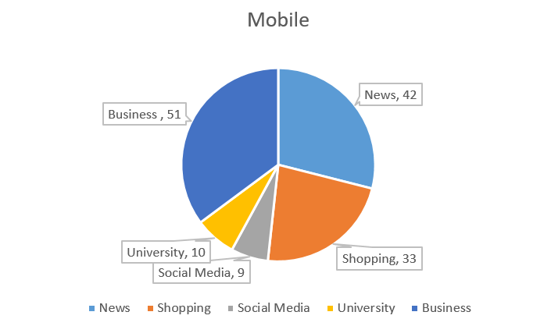
Third party site blocked in Desktop vs Mobile

Slide 13
Observations of Third party site blocked in Desktop vs Mobile using Ghostery
The blacklisted sites on desktop browsing are less compared to the ones in Mobile browsing
Ghostery on mobile blocks more site unlike desktop
Few common trackers that are blocked by mobile and not desktop are as follows:
Advertising Trackers: facebook custom audience, demandbase, facebook pixel, beeswax
Site Analytics : Score Card , Google analytics, Research Beacon
Social Media : LinkedIn Widget , Facebook social plugin

Slide 14

Lumen Privacy Monitor
Using Lumen Privacy Monitor we did a comparative study on the apps across different domains.
No. of trackers with respect to domain type
Most common trackers across apps
Dangerous leaks in apps

Slide 15
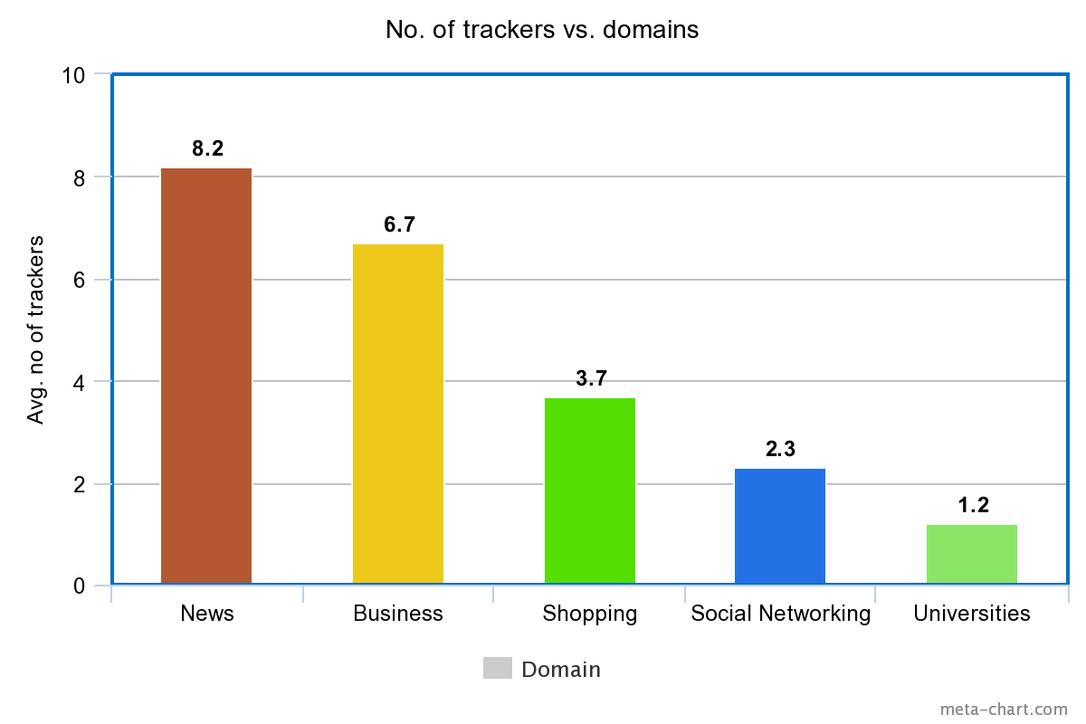
Lumen: No. of trackers vs. domains

Slide 16
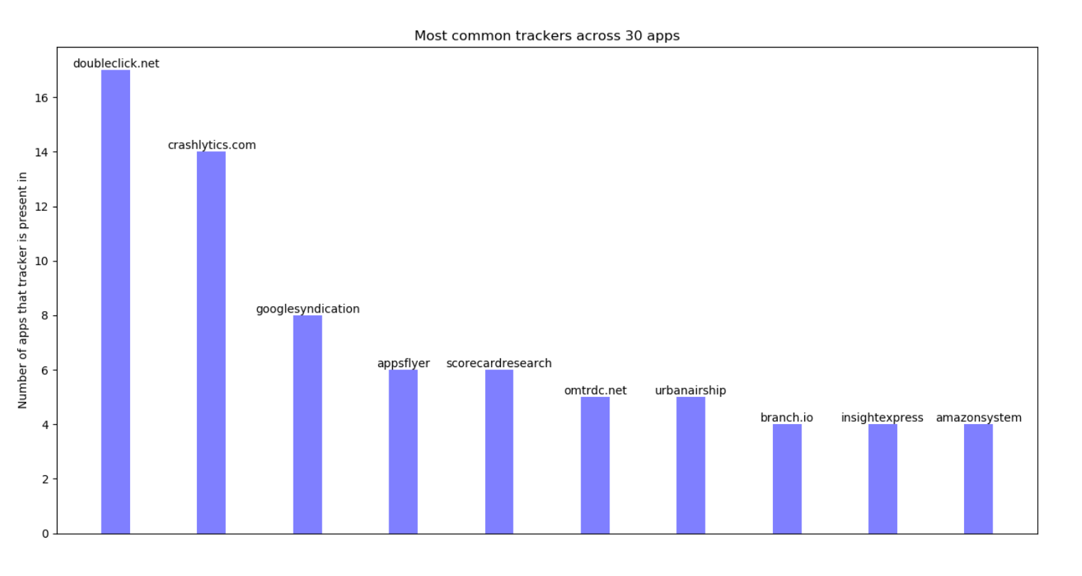
Lumen: Most common trackers

Slide 17
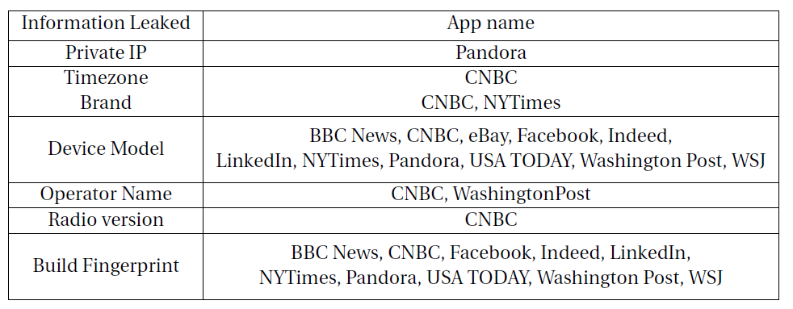
Lumen: Dangerous Leaks in Apps

Slide 18
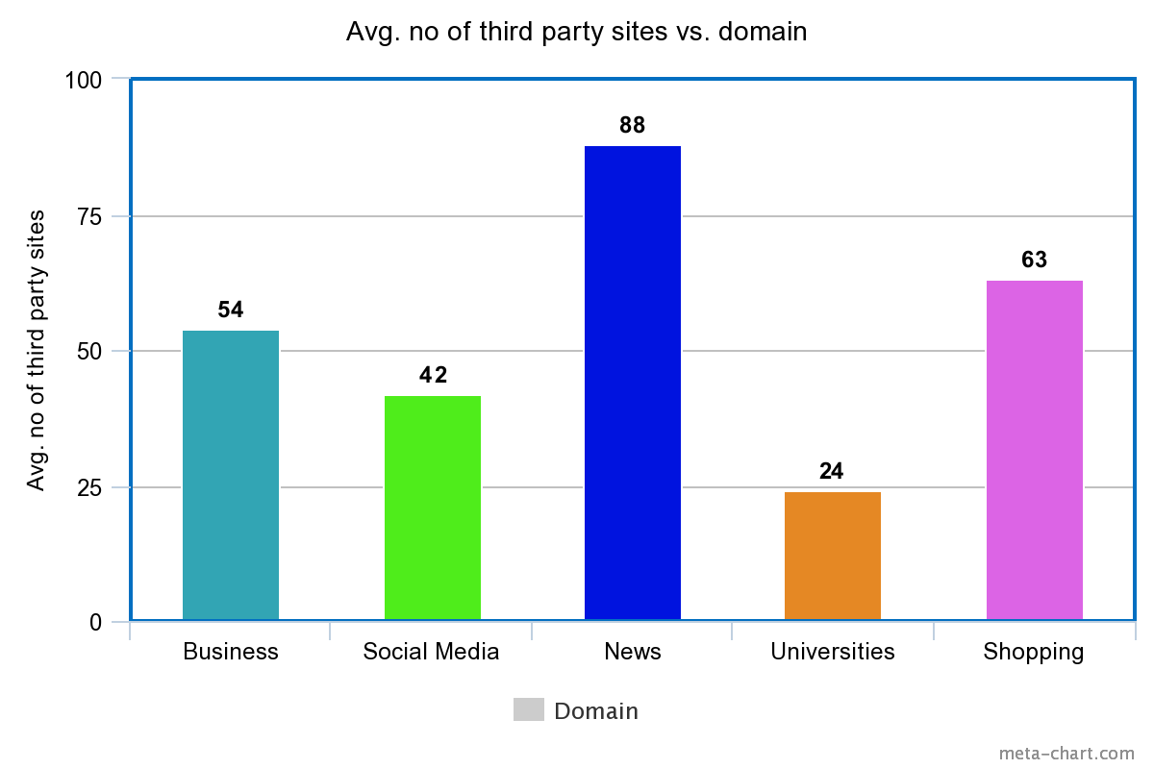
OpenWPM : Third party behaviour

Slide 19
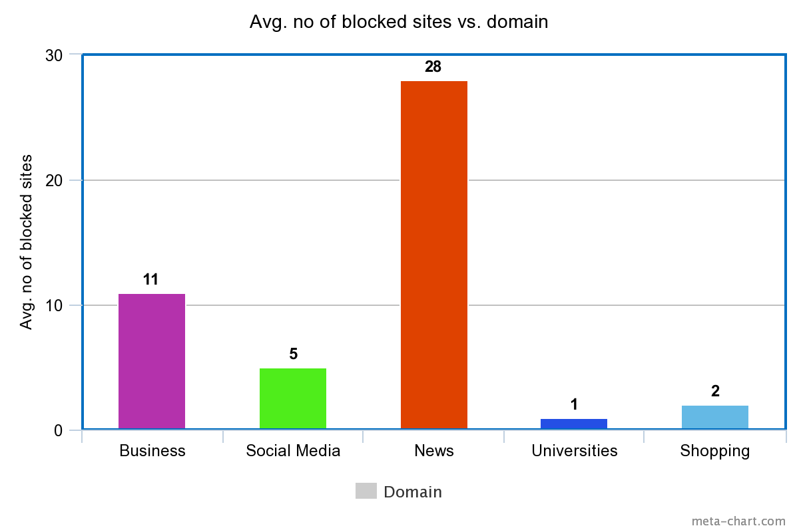
OpenWPM: Blocked sites for each domain

Slide 20
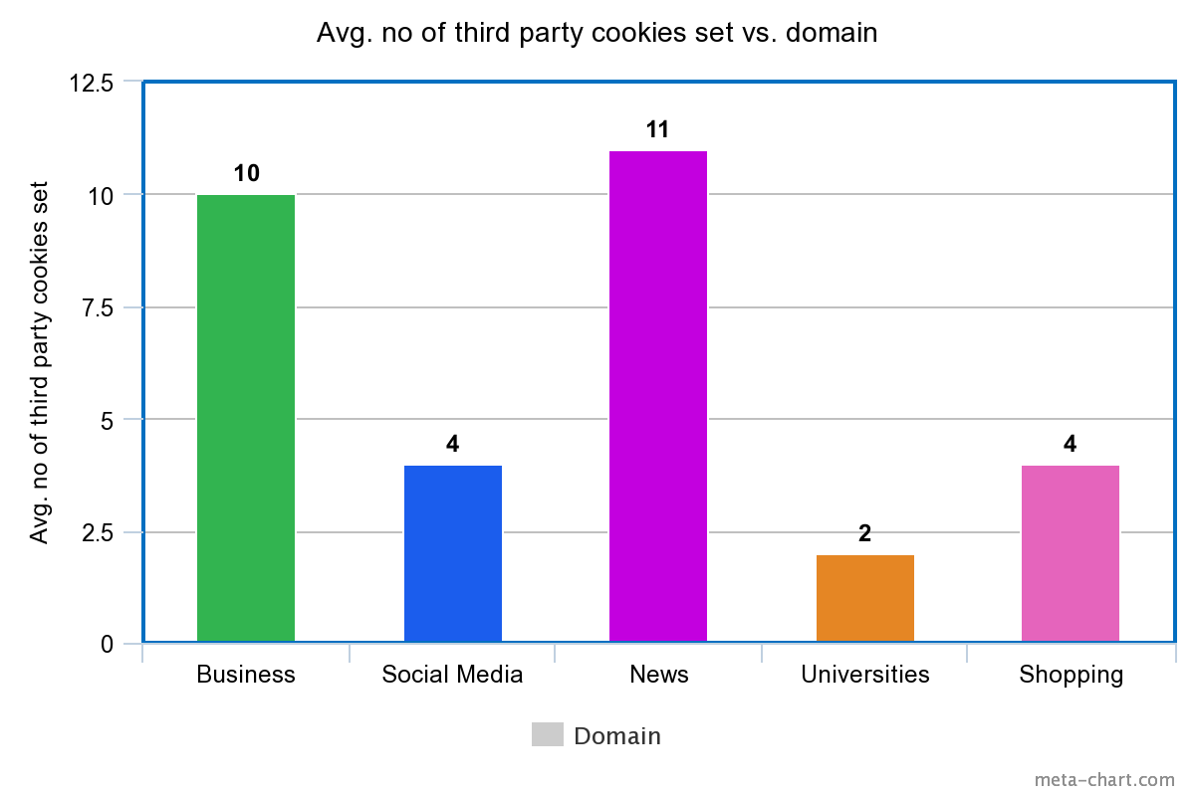
OpenWPM: Cookie data analysis

Slide 21
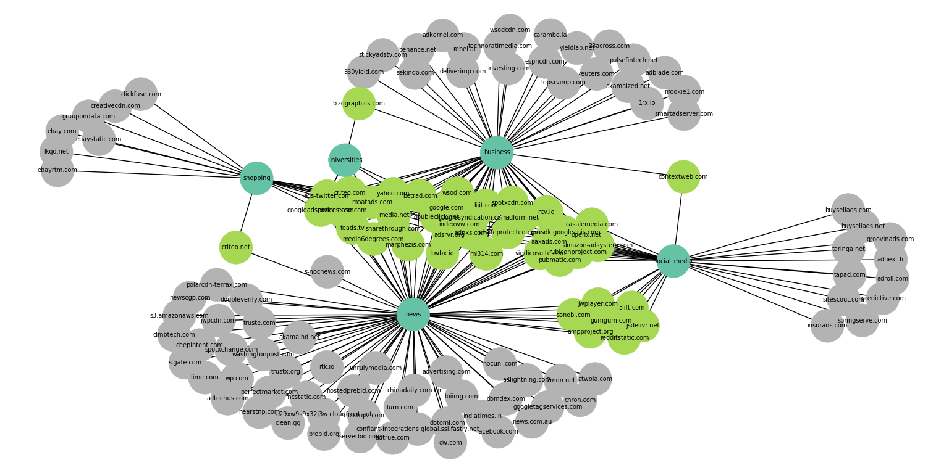
Understanding common trackers through Network Diagram:

Slide 22
Summary of findings:
Many trackers are common across multiple apps. The network diagram gives an idea of the common trackers across domains.
Many of the apps leak sensitive information such as private IP in some cases and device model and build fingerprint in most of the apps.
On comparing the third party sites and the sites blocked through Ghostery, we find that the number of trackers on mobile is more than on desktop.
Many of the trackers that are found on mobile are not found on desktop.

Slide 23
Summary of findings:
On analysing the third party request and blocked sites data using OpenWPM, we find that on an average news domain has most number of trackers. This is followed by business and shopping domains. University websites have the least number of trackers.
News domains have the maximum number of third party cookies set. Most of the third party cookies have expiry date far in the future i.e indefinitely.

Slide 24
Limitations and future work
Lumen does not use the same blacklist as Ghostery. Hence we could not do a comparative study across all 3 platforms - apps, mobile browser and desktop browser.
Lumen only works for Android ecosystem and no app for IOS that could monitor the app traffic and block trackers.
This study was conducted across limited number of sites. We would like to increase the number of sites to gain more data to analyse.
Do a comparative study on more parameters to help in understanding the tracking ecosystem of desktop vs mobile.

